Slide 1
CSE231 – Digital Logic Design
Basic Logic Operations,
Boolean Expressions,
and
Boolean Algebra

Slide 2
Basic Logic Operations

Slide 3
Basic Logic Operations
AND
OR
NOT (Complement)
Order of Precedence
  NOT
  AND
  OR
  can be modified using parenthesis

Slide 4
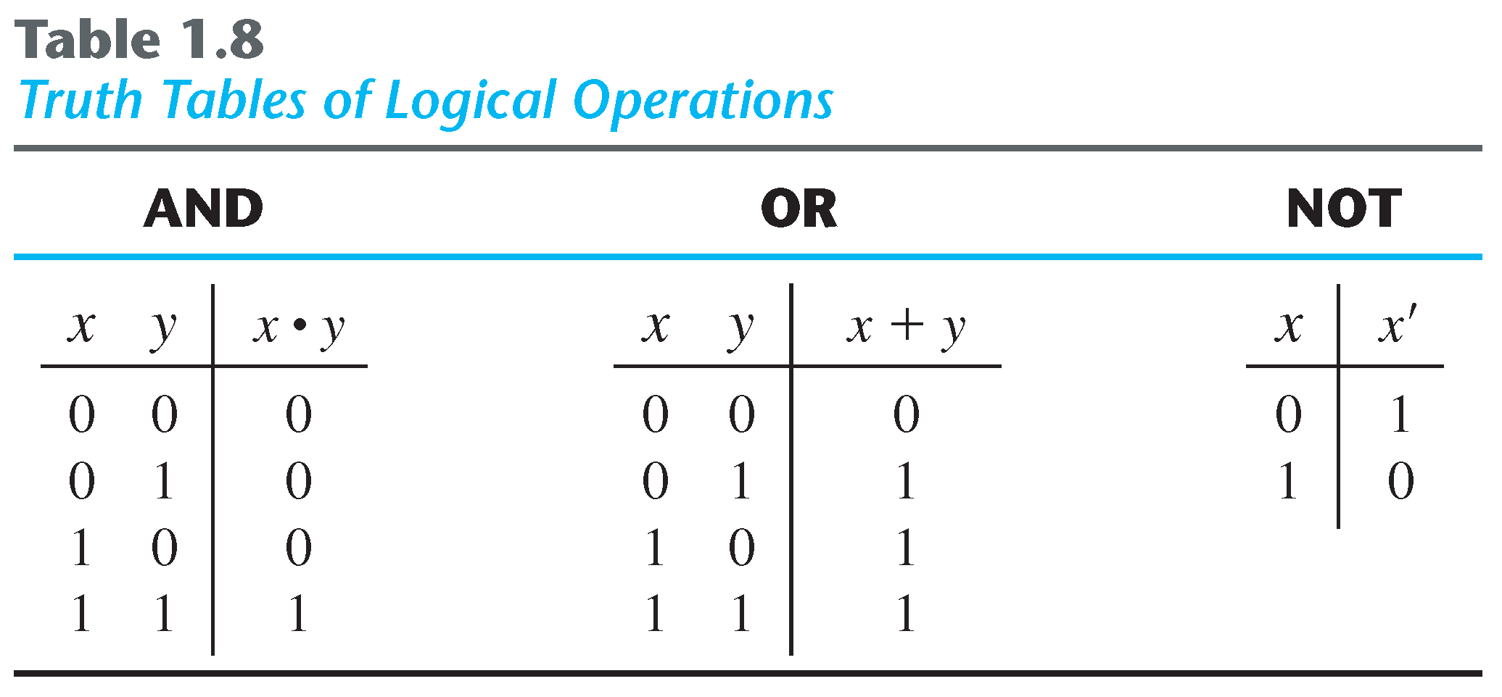
Basic Logic Operations

Slide 5
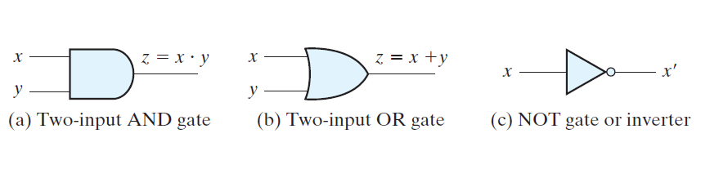
Basic Logic Operations

Slide 6
Additional Logic Operations
NAND
  F = (A . B)'
NOR
  F = (A + B)'
XOR
  Output is 1 iff either input is 1, but not both.
XNOR (aka. Equivalence)
  Output is 1 iff both inputs are 1 or both inputs are 0.

Slide 7
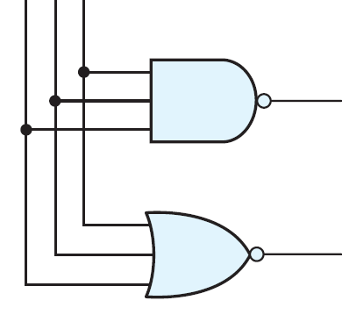
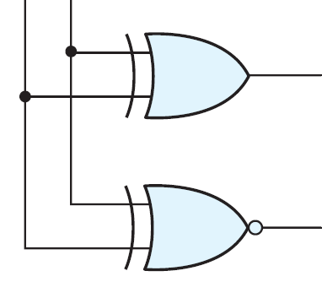
Additional Logic Operations
NAND
XOR
NOR
denotes inversion
XNOR

Slide 8
Additional Logic Operations
Exercise:
Derive the Truth table for each of the following logic operations:
1. 2-input NAND
2. 2-input NOR

Slide 9
Additional Logic Operations
Exercise:
Derive the Truth table for each of the following logic operations:
1. 2-input XOR
2. 2-input XNOR

Slide 10
Truth Tables

Slide 11
Truth Tables
Used to describe the functional behavior of a Boolean expression and/or Logic circuit.
Each row in the truth table represents a unique combination of the input variables.
  For n input variables, there are 2^{n} rows.
The output of the logic function is defined for each row.
Each row is assigned a numerical value, with the rows listed in ascending order.
The order of the input variables defined in the logic function is important.

Slide 12
3-input Truth Table
F(A,B,C) = Boolean expression

Slide 13
4-input Truth Table
F(A,B,C,D) = Boolean expression

Slide 14
Boolean Expressions

Slide 15
Boolean Expressions
Boolean expressions are composed of
  Literals – variables and their complements
  Logical operations
Examples
  F = A.B'.C + A'.B.C' + A.B.C + A'.B'.C'
  F = (A+B+C').(A'+B'+C).(A+B+C)
  F = A.B'.C' + A.(B.C' + B'.C)
literals
logic operations

Slide 16
Boolean Expressions
Boolean expressions are realized using a network (or combination) of logic gates.
  Each logic gate implements one of the logic operations in the Boolean expression
  Each input to a logic gate represents one of the literals in the Boolean expression
A
B
literals
logic operations
f

Slide 17
Boolean Expressions
Boolean expressions are evaluated by
  Substituting a 0 or 1 for each literal
  Calculating the logical value of the expression
A Truth Table specifies the value of the Boolean expression for every combination of the variables in the Boolean expression.
For an n-variable Boolean expression, the truth table has 2^{n} rows (one for each combination).

Slide 18
Boolean Expressions
Example:
Evaluate the following Boolean expression, for all combination of inputs, using a Truth table.
F(A,B,C) = A'.B'.C + A.B'.C' + A.C

Slide 19
Boolean Expressions
Two Boolean expressions are equivalent if they have the same value for each combination of the variables in the Boolean expression.
  F₁ = (A + B)'
  F₂ = A'.B'
How do you prove that two Boolean expressions are equivalent?
  Truth table
  Boolean Algebra

Slide 20
Boolean Expressions
Example:
Using a Truth table, prove that the following two Boolean expressions are equivalent.
F₁ = (A + B)'
F₂ = A'.B'

Slide 21
Boolean Algebra

Slide 22
Boolean Algebra
George Boole developed an algebraic description for processes involving logical thought and reasoning.
  Became known as Boolean Algebra
Claude Shannon later demonstrated that Boolean Algebra could be used to describe switching circuits.
  Switching circuits are circuits built from devices that switch between two states (e.g. 0 and 1).
  Switching Algebra is a special case of Boolean Algebra in which all variables take on just two distinct values
Boolean Algebra is a powerful tool for analyzing and designing logic circuits.

Slide 23
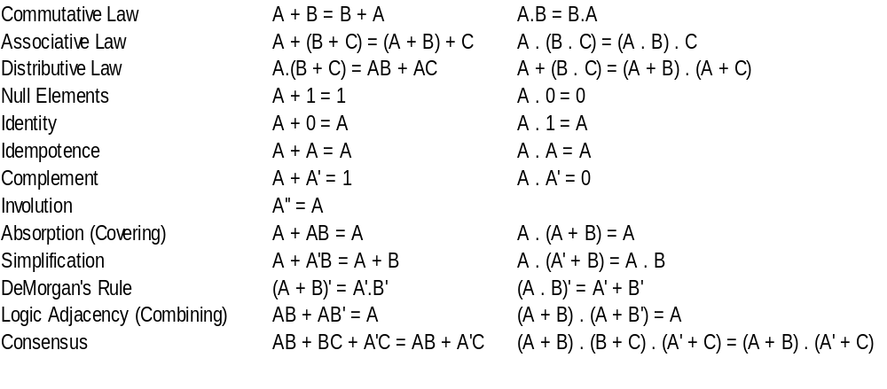
Basic Laws and Theorems

Slide 24
Idempotence
A + A = A
F = ABC + ABC' + ABC
F = ABC + ABC'
Note: terms can also be added using this theorem
A . A = A
G = (A' + B + C').(A + B' + C).(A + B' + C)
G = (A' + B + C') + (A + B' + C)
Note: terms can also be added using this theorem

Slide 25
Complement
A + A' = 1
F = ABC'D + ABCD
F = ABD.(C' + C)
F = ABD
A . A' = 0
G = (A + B + C + D).(A + B' + C + D)
G = (A + C + D) + (B . B')
G = A + C + D

Slide 26
Distributive Law
A.(B + C) = AB + AC
F = WX.(Y + Z)
F = WXY + WXZ
G = B'.(AC + AD)
G = AB'C + AB'D
H = A.(W'X + WX' + YZ)
H = AW'X + AWX' + AYZ
A + (B.C) = (A + B).(A + C)
F = WX + (Y.Z)
F = (WX + Y).(WX + Z)
G = B' + (A.C.D)
G = (B' + A).(B' + C).(B' + D)
H = A + ( (W'X).(WX') )
H = (A + W'X).(A + WX')

Slide 27
Absorption (Covering)
A + AB = A
F = A'BC + A'
F = A'
G = XYZ + XY'Z + X'Y'Z' + XZ
G = XYZ + XZ + X'Y'Z'
G = XZ + X'Y'Z'
H = D + DE + DEF
H = D
A.(A + B) = A
F = A'.(A' + BC)
F = A'
G = XZ.(XZ + Y + Y')
G = XZ.(XZ + Y)
G = XZ
H = D.(D + E + EF)
H = D

Slide 28
Simplification
A + A'B = A + B
F = (XY + Z).(Y'W + Z'V') + (XY + Z)'
F = Y'W + Z'V' + (XY + Z)'
A.(A' + B) = A . B
G = (X + Y).( (X + Y)' + (WZ) )
G = (X + Y) . WZ

Slide 29
Logic Adjacency (Combining)
A.B + A.B' = A
F = (X + Y).(W'X'Z) + (X + Y).(W'X'Z)'
F = (X + Y)
(A + B).(A + B') = A
G = (XY + X'Z').(XY + (X'Z')' )
G = XY

Slide 30
Boolean Algebra
Example:
Using Boolean Algebra, simplify the following Boolean expression.
F(A,B,C) = A'.B.C + A.B'.C + A.B.C

Slide 31
Boolean Algebra
Example:
Using Boolean Algebra, simplify the following Boolean expression.
F(A,B,C) = (A'+B'+C').(A'+B+C').(A+B'+C')

Slide 32
DeMorgan's Laws
Can be stated as follows:
  The complement of the product (AND) is the sum (OR) of the complements.
    (X.Y)' = X' + Y'
  The complement of the sum (OR) is the product (AND) of the complements.
    (X + Y)' = X' . Y'
Easily generalized to n variables.
Can be proven using a Truth table

Slide 33
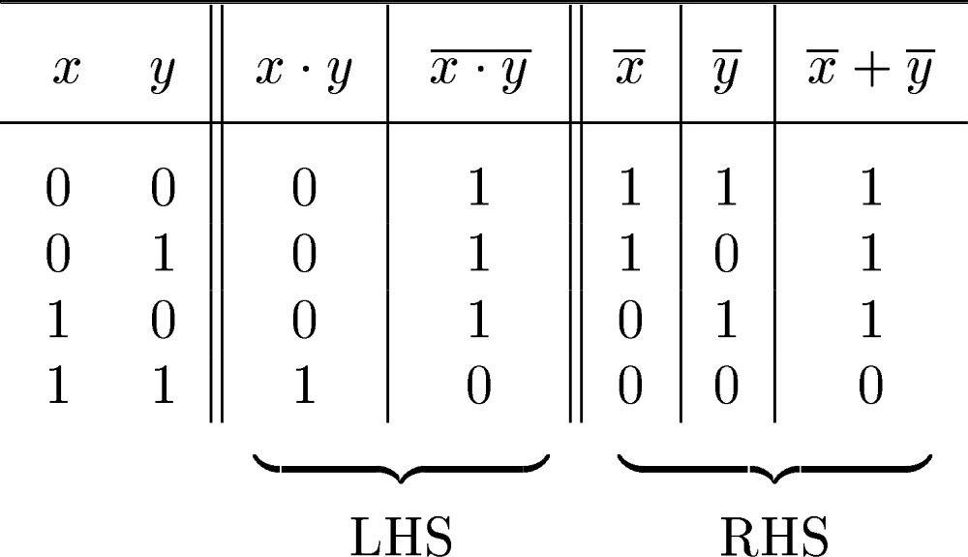
Proving DeMorgan's Law
(X . Y)' = X' + Y'

Slide 34
DeMorgan's Theorems
x
1
x
1
x
1
x
2
x
2
x
2
(a)
x
1
x
2
=
x
1
+
x
2
x
1
x
1
x
1
x
2
x
2
x
2
(b)
x
1
+
x
2
=
x
1
x
2

Slide 35
Importance of Boolean Algebra
Boolean Algebra is used to simplify Boolean expressions.
  Through application of the Laws and Theorems discussed
Simpler expressions lead to simpler circuit realization, which, generally, reduces cost, area requirements, and power consumption.
The objective of the digital circuit designer is to design and realize optimal digital circuits.

Slide 36
Algebraic Simplification
Justification for simplifying Boolean expressions:
  Reduces the cost associated with realizing the expression using logic gates.
  Reduces the area (i.e. silicon) required to fabricate the switching function.
  Reduces the power consumption of the circuit.
In general, there is no easy way to determine when a Boolean expression has been simplified to a minimum number of terms or minimum number of literals.
  No unique solution

Slide 37
Algebraic Simplification
Boolean (or Switching) expressions can be simplified using the following methods:
  Multiplying out the expression
  Factoring the expression
  Combining terms of the expression
  Eliminating terms in the expression
  Eliminating literals in the expression
  Adding redundant terms to the expression
As we shall see, there are other tools that can be used to simplify Boolean Expressions.
Namely, Karnaugh Maps.

